Slide 1
Web APIs & Classification
r/AppleWatch & r/GalaxyWatch
Nandhini Manoharan

Slide 2
Contents
Problem Statement
Data cleaning
EDA
Modelling
Conclusion

Slide 3
Problem Statement
Using Reddit's API, collect posts from two subreddits
Use NLP to train a classifier on which subreddit a given post came from.
What characteristics of a post on Reddit contribute most to what subreddit it belongs to?

Slide 4
Data Cleaning
Removed duplicate posts
Imputed NaN selftext with empty string
1777texts

Slide 5
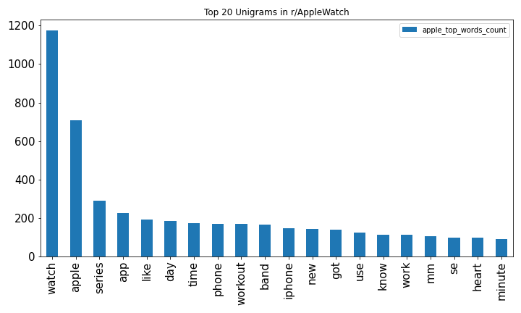
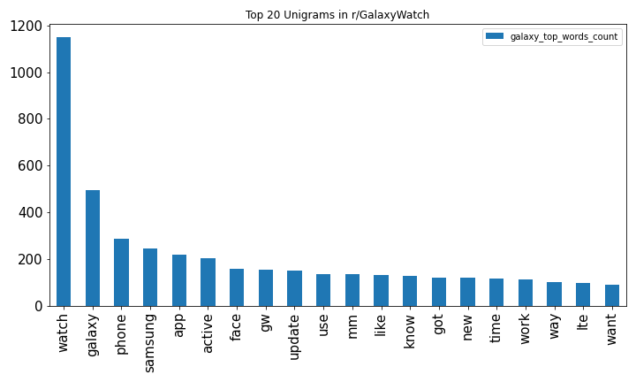
EDA
Top 20 AppleWatch & GalaxyWatch Unigrams

Slide 6
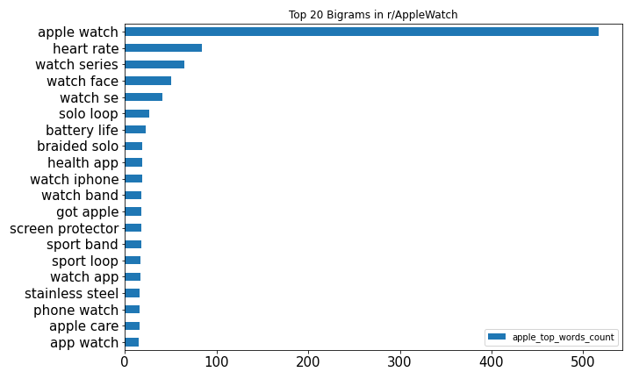
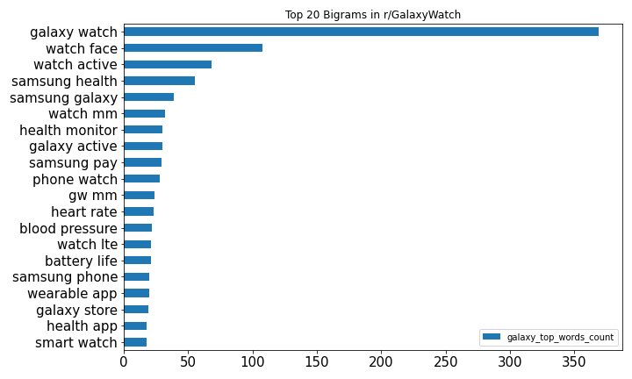
Top 20 AppleWatch & GalaxyWatch Bigrams

Slide 7
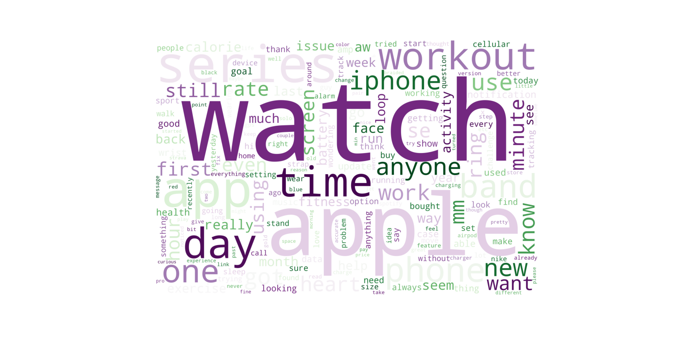
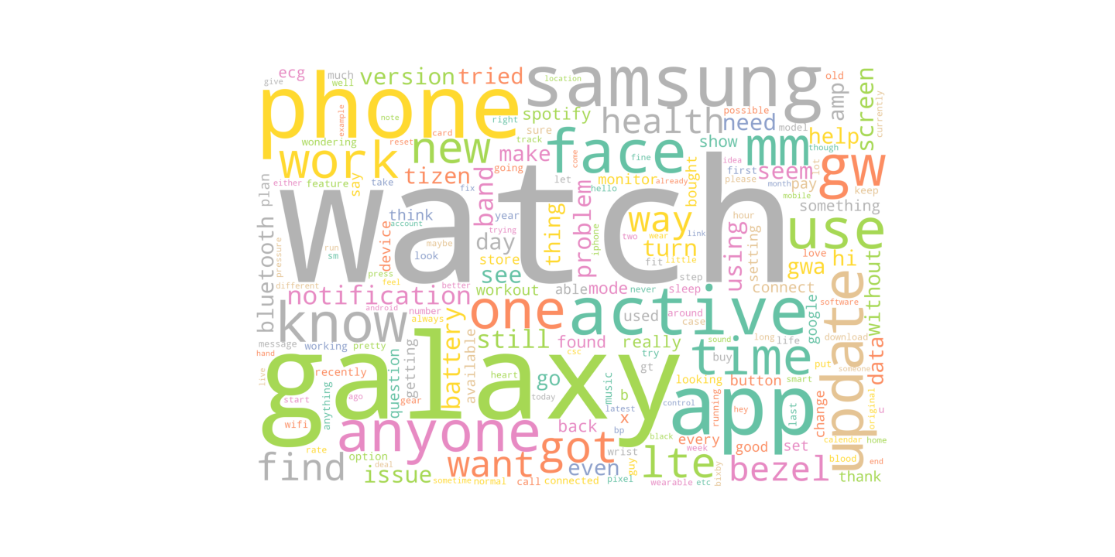
Wordcloud

Slide 8
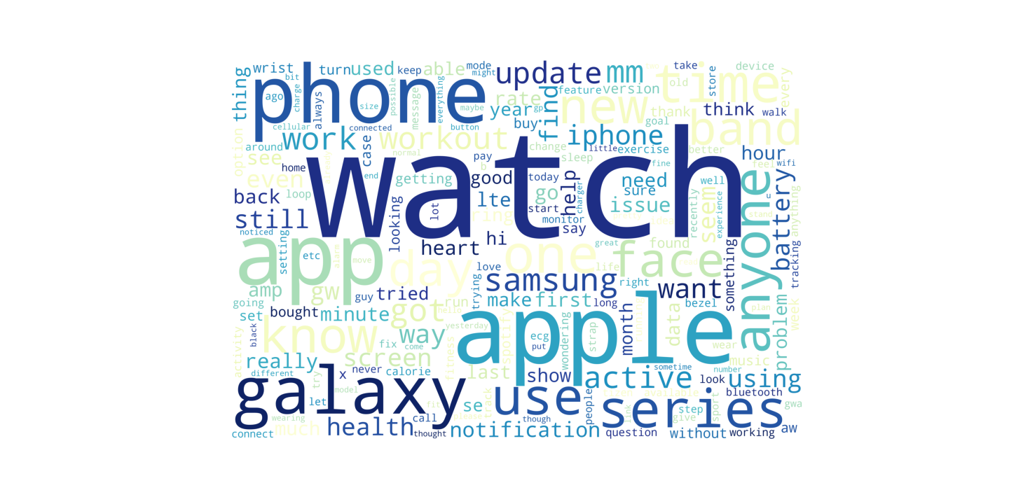
Common words

Slide 9
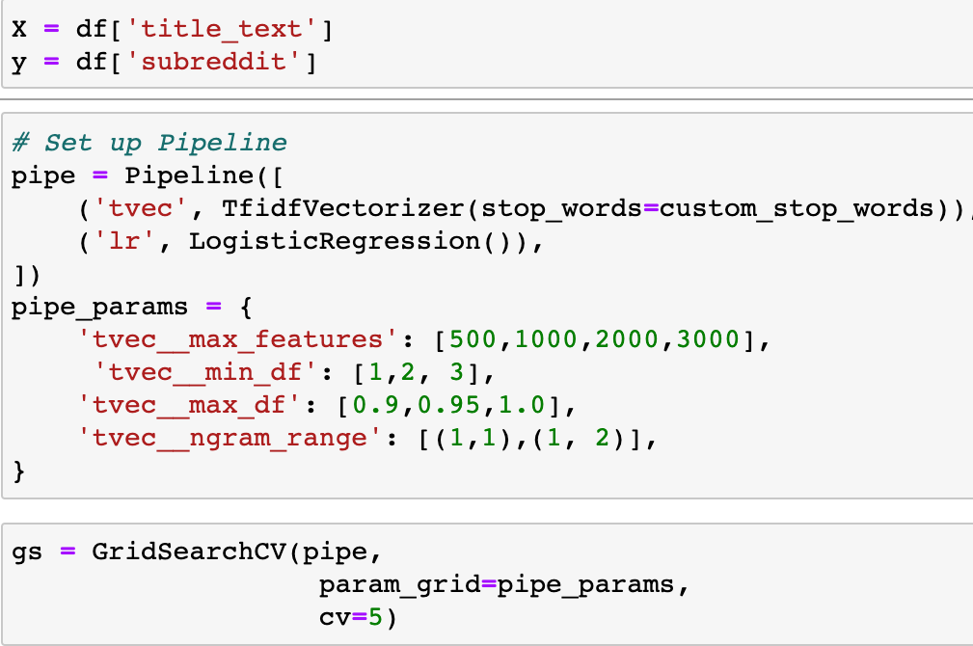
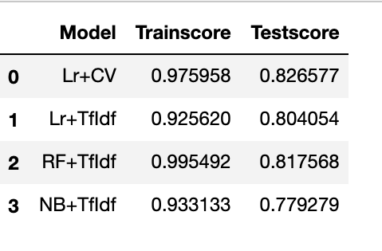
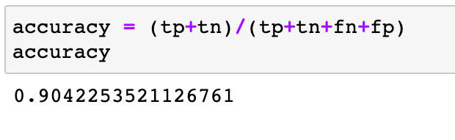
Modelling

Slide 10
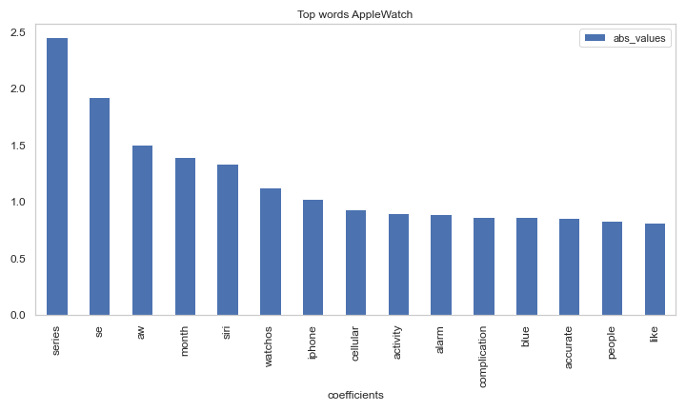
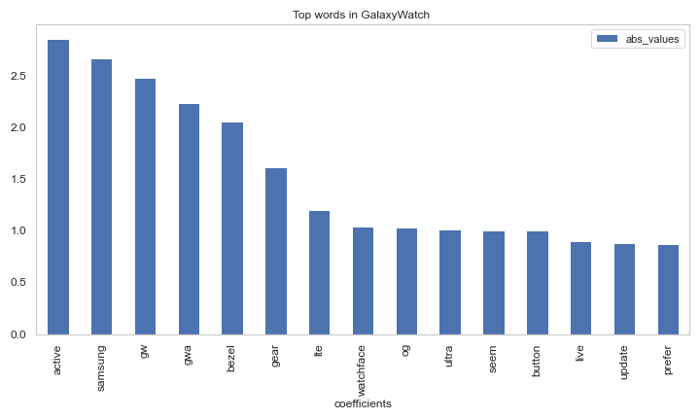
Interpretations

Slide 11
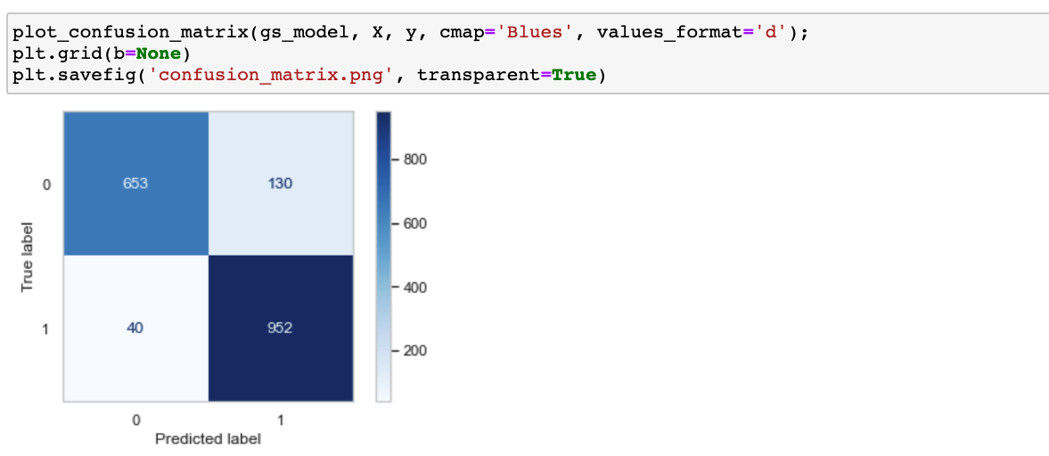
Confusion Matrix

Slide 12
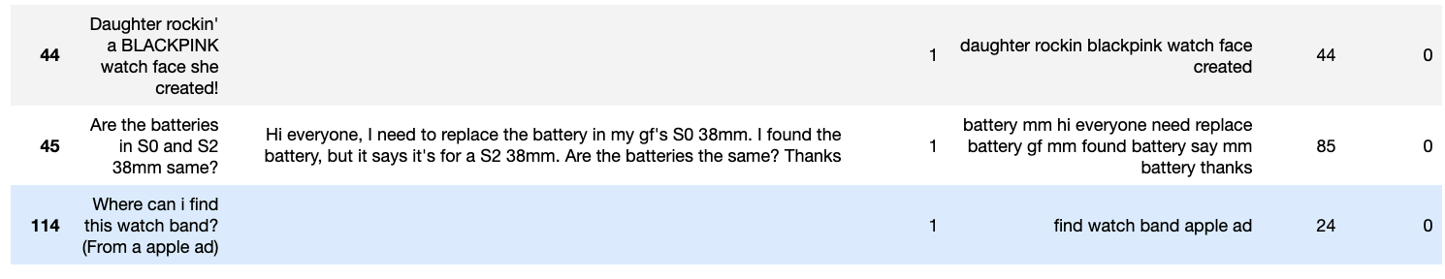
Misclassified posts

Slide 13
Conclusion
r/AppleWatch - recent models, latest features and daily usage with health monitoring.
-Monthly challenges, exercise ring, workout app and activity app in r/AppleWatch subreddits
-Ringfeature also became a top classifier along with 'blue' keyword(representing Stand).
-Loop model also topped in the classification due to its excellent review than Sport band and buckle models.
r/GalaxyWatch- talk more about features such as OS,updates, bezel and buttons. There seemed to be issue with the galaxy watch buttons which was reflected in the posts and hence appeared in top classifiers of galaxy subreddit.
Collect more data
Findings can be used by companies or the users to better understand the top features that people are discussing and further sentiment analysis on this data could be used to find the positive or negative review about the watches.

Slide 14
Thank you

